Slide 1
Python for Data Science:
ML Introduction
Presented by: Hussein El Amouri
Prepared by: Mathilda Khalil

Slide 2
Machine Learning Bootcamp

Slide 3
AI, Machine Learning & Deep Learning
Artificial intelligence
Machines that mimic human intelligence.
Machine learning
Learn patterns from data to make predictions.
Deep learning
Neural networks that handle complex data

Slide 4
Machine Learning Infographics
01
02
Supervised Learning
Unsupervised Learning
Learn from labeled data (inputs + outputs).
Find hidden patterns in unlabeled data.
Machine learning
03
Reinforcement Learning
Learn by interacting with the environment and receiving feedback.

Slide 5
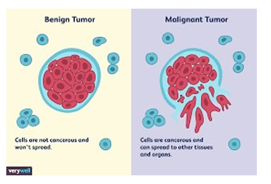
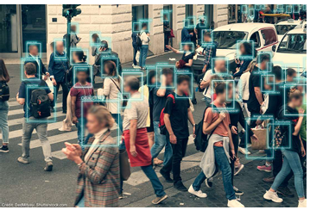
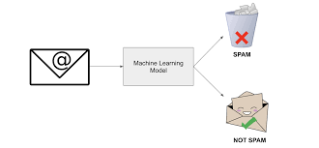
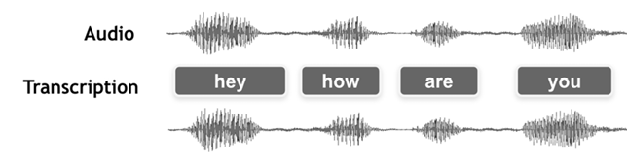
Applications of ML
Medical field: Analysis of the shape and color of cells to detect cancer
Computer vision: Face detection, automatic language translation, speech recognition.

Slide 6
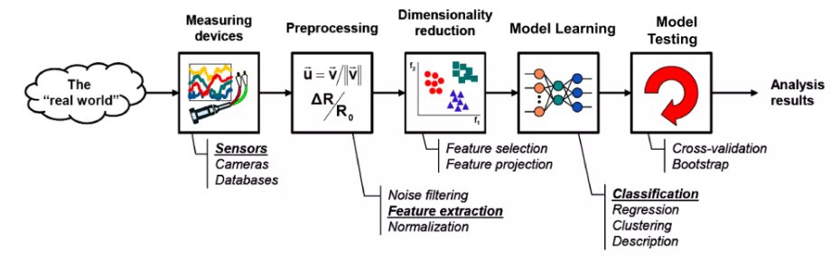
Learning Process

Slide 7
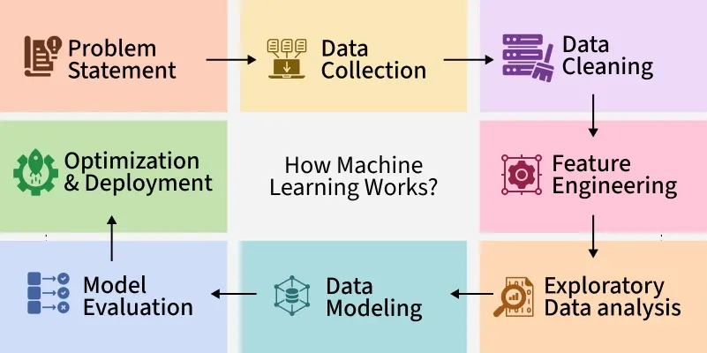
Machine Learning Workflow
Pandas
Pandas
Numpy
Collect Data
Preprocess Data
Split into Train/Test sets
Train Model
Evaluate & Improve
Deploy & Use Predictions
Pandas
Sklearn
Sklearn
Numpy
Matplotlib&Seaborn
Sklearn
Numpy
Pandas
Matplotlib
Seaborn

Slide 8
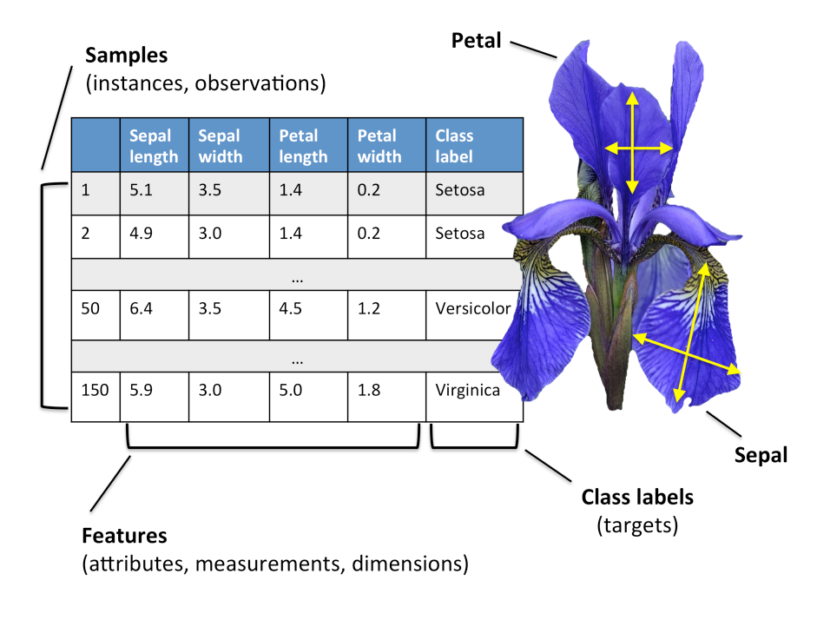
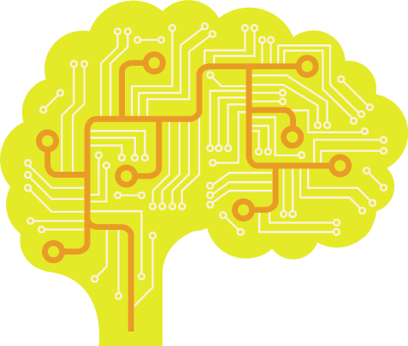
Step 1: Collect Data
In the Iris dataset: 150 samples, 4 features (sepal length, sepal width, petal length, petal width).
3 flower species (target): Setosa, Versicolor, Virginica.
Pandas
DataFrame,
Table Like Object

Slide 9
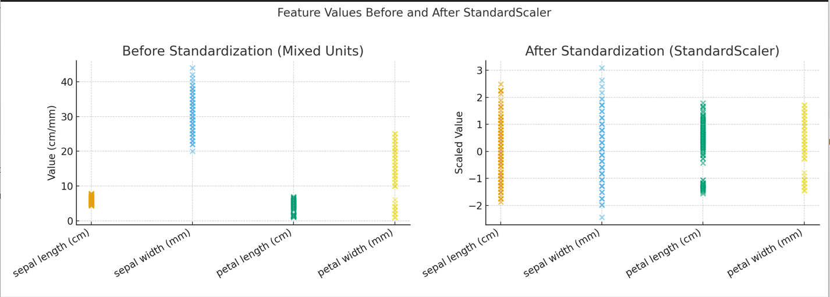
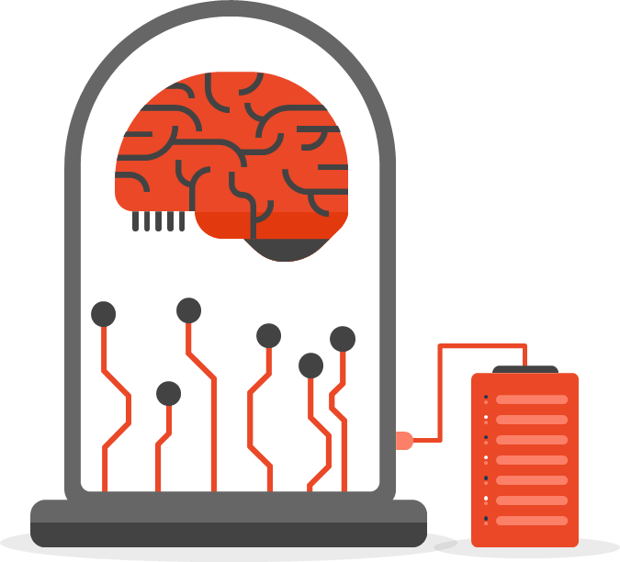
Step 2: Preprocess Data
Ensure data is clean: no missing values, duplicates.
Normalize features: petal length (cm) vs sepal width (mm) → scale them for fairness.
Why? Some ML algorithms are sensitive to scale (e.g., k-NN, SVM).
Iris dataset features are often standardized.

Slide 10
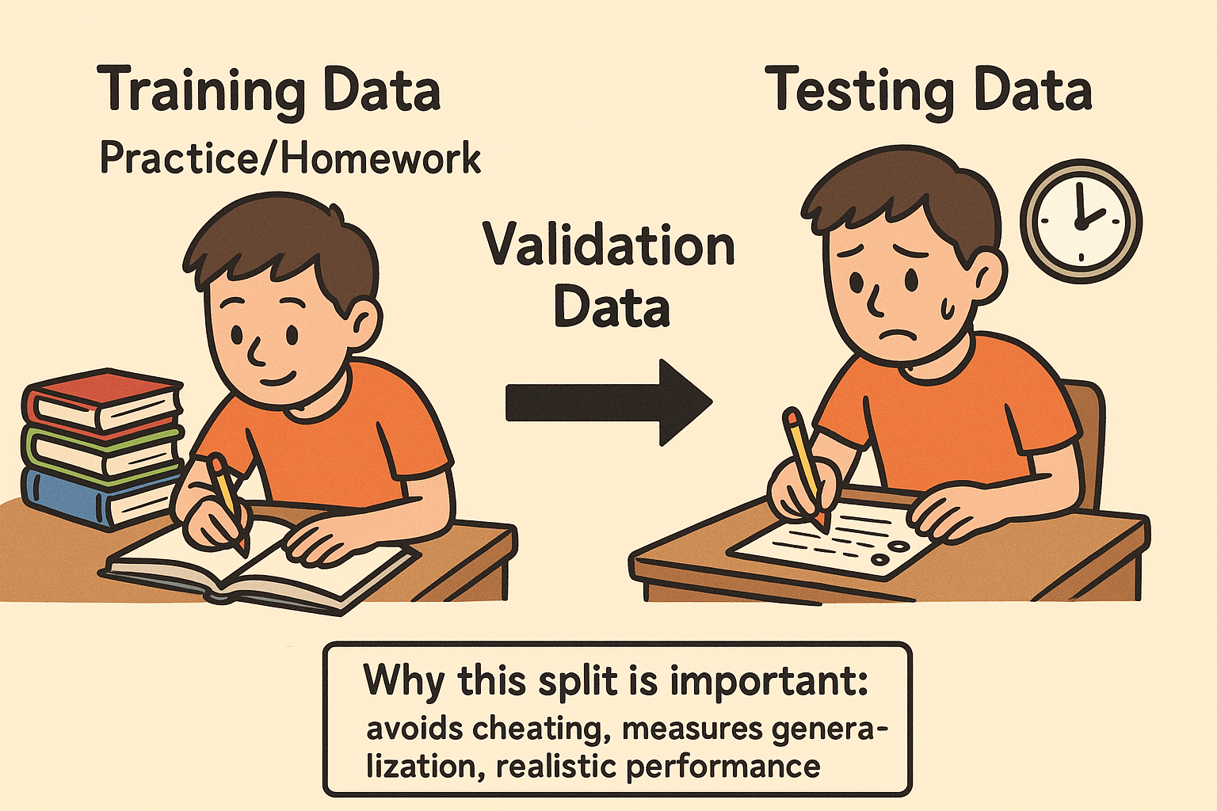
Step 3: Split Data
We split into Training and Testing sets to evaluate performance.
Training set → model learns patterns.
Testing set → evaluate generalization on unseen data.
Validation set → tune hyperparameters, prevent overfitting.
Training Data
Lecture/Homework
Validation Data
Quiz
Testing Data
EXAM

Slide 11
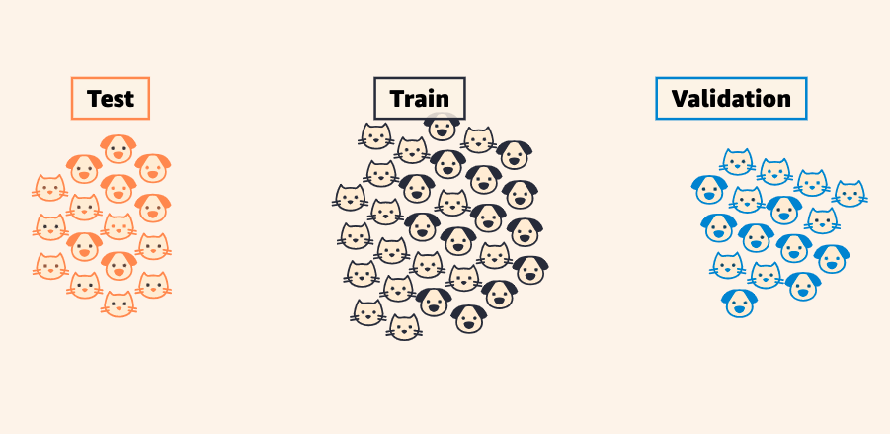
Step 3: Split Data
We split into Training and Testing sets to evaluate performance.
Training set → model learns patterns.
Testing set → evaluate generalization on unseen data.
Validation set → tune hyperparameters, prevent overfitting.

Slide 12
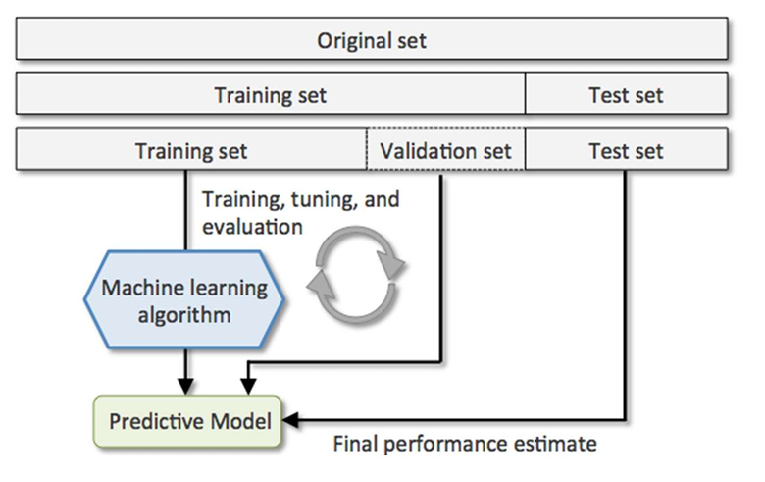
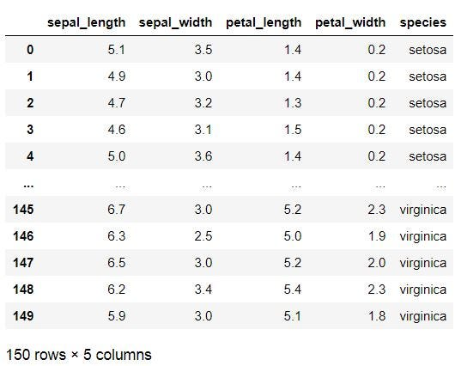
Step 3: Split Data
We split into Training and Testing sets to evaluate performance.
Training set → model learns patterns.
Testing set → evaluate generalization on unseen data.
Validation set → tune hyperparameters, prevent overfitting.
Example: 120 samples for training, 30 samples for testing.
30 samples

Slide 13
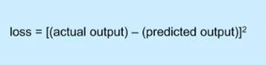
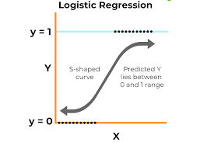
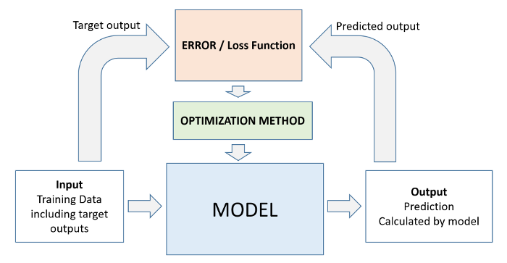
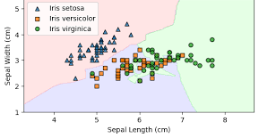
Step 4: Train the Model
The model learns relationships between inputs and outputs.
Uses an optimization algorithm (Gradient Descent) to adjust parameters.
Loss Function: measures how far predictions are from actual labels
In Iris: features (petal & sepal sizes) → predict species label.
Example: Train a Logistic regression to separate Setosa vs others.

Slide 14
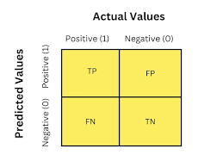
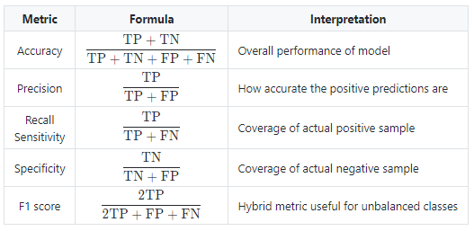
Step 5: Evaluate the Model
Use metrics to measure performance.
Accuracy = % of correct predictions.
Confusion Matrix shows detailed prediction results per class.

Slide 15
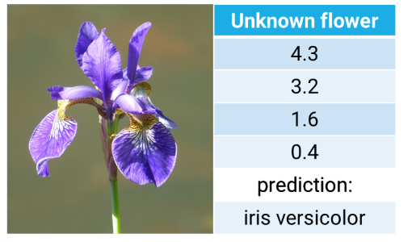
Step 6: Make Predictions
After training, we can predict on new flower samples.
Input: Petal length=5.0, Petal width=1.8 → Model predicts Versicolor.
This is the final output of the ML pipeline.
Model outputs probabilities:
Setosa = 3%
Versicolor = 82%
Virginica = 15%
Features
Target

Slide 16
Definitions by God Fathers of AI
Tom M. Mitchell:
"A computer program is said to learn from experience E with respect to some class of tasks T and performance measure P, if its performance at tasks in T, as measured by P, improves with experience E." — Machine Learning (1997)
Geoffrey Hinton
“Deep learning is about learning multiple levels of representation and abstraction that help make sense of data such as images, sound, and text.”
Yann LeCun
“AI is the science of making machines smart.”
“Deep learning uses deep neural networks to extract increasingly abstract features from raw data.”
Yoshua Bengio
“Deep learning is representation learning with multiple levels of abstraction, achieved by composing simple but non-linear modules.”

